Slide 1
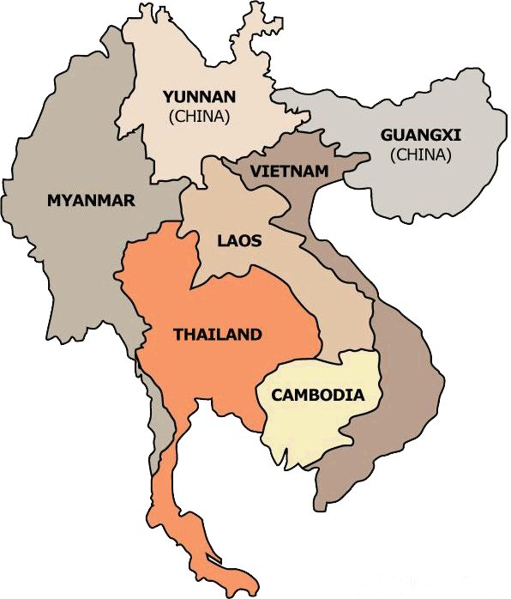
KACHIN
Additional file 1: Fig. S1. Map of GMS showing the two border regions (stars) where Plasmodium vivax clinical samples were collected (Modified fromhttps://hkmb.hktdc.com/en/1X0A2LSH/hktdc-research/Opportunities-in-Thailand%E2%80%99s-Logistics-Market).

